Slide 1
Mental Health Social Media Application
By:Shirdora Ashe
Notes:
Good evening, my name is Shirdoa Ashe and i will be talking about my mental health social media application.

Slide 2

Problem Background
50 million Americans suffer from some kind on mental illness
Existing Gap: Lack of accessible, stigma-free platforms
Notes:
In today's digital era, mental health has emerged as a significant concern, with individuals facing numerous challenges such as stigma, limited accessibility to resources, and inadequate community support. Currently, there are about 50 million americans that suffer from some kind of mental illness. Despite increased awareness, there remains a substantial gap in providing accessible and stigma-free platforms for individuals to share their experiences and access resources. Existing social media platforms often lack tailored features and environments for those grappling with mental illnesses, resulting in a lack of safe and inclusive spaces for seeking support and understanding. Consequently, there is a critical need for a dedicated social media application that offers empathy and support to individuals dealing with mental health issues.

Slide 3

Project Justification
Growing Concern: Rising Mental Health issues in the digital age
Usage Statistics: High Usage of social media among those with mental illness
Positive Impact: Studies show engagement with social media can improve mental health
Need for dedicated platform: Providing tailored support for mental health challenges
Notes:
The project justification for developing a dedicated social media application for individual grappling with mental health challenges. The need for this stems from addressing a critical need for a significant gap in accessibility and stigma-free platforms for individuals facing mental health challenges to share experiences, access resources, and foster supportive communities. Existing social media platforms often lack tailored features and support mechanisms specific to mental health needs. With the creation of a social media application that focuses on mental will lead to a more positive outlook on mental health and lead to a community where those can express their experiences and help each other.

Slide 4
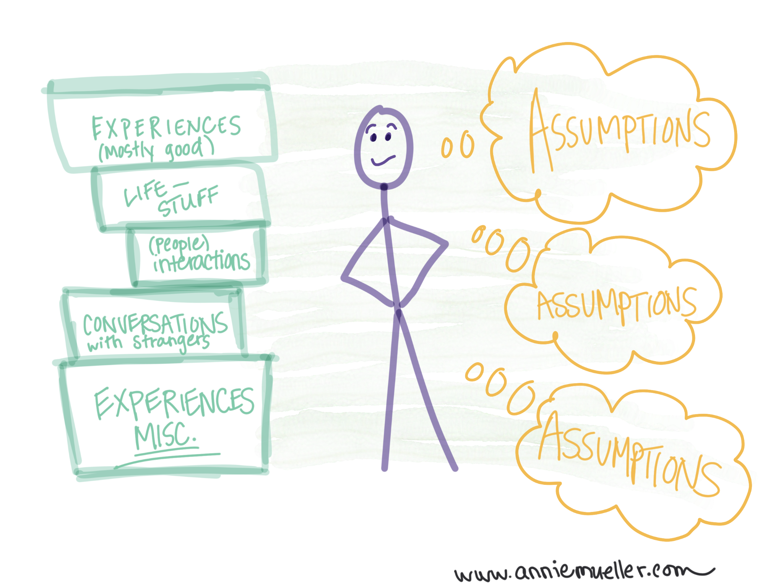
Assumptions
Individuals express interest in accessing mental health support via digital platform
Significant amount of people have access to digital platforms or use some sort of social media
Individuals are willing to engage with the platform and continue to engage in it over time
Notes:
During the completion of this project, we must have certain assumptions in place before development. An assumption is that many individuals express interred in accessing mental health support and resources via digital platforms. According to the research, there are about 50 million Americans who suffer from mental illnesses. (Mental Health America, 2022). A significant portion of those people have access to digital platforms or use some type of social media. (Petrosyan, 2024). We assume that users are willing to engage with the platform and will continue to participate in discussions, share their experiences, or seek assistance when needed. The last assumption to address is accessibility. We can assume that a significant population of those with mental illnesses have access to mobile or digital devices. (Young, 2019).

Slide 5

Constraints
Technical
Developing a robust user-friendly social media application
Including
Data security
Scalability
Seamless user experience
Regulatory
Legal requirements concerning data privacy and mental health information
User Engagement
Active participation from desired audience
Notes:
For this project, we can categorize some of the challenges as technical, regulatory, and user engagement. The technical challenge that the project may run into is developing a robust and user-friendly social media application with features tailored to mental health support, which includes ensuring data security, scalability, and seamless user experiences across various devices. With the regulatory challenges, the project may have to adhere to strict regulations concerning data privacy and mental health information. Throughout the development process of a published project, one may need to consider legal and ethical considerations. (Wong, 2023). Another challenge is user engagement. Encouraging active participation and ongoing engagement from individuals with mental illnesses may prove challenging. Stigma or privacy concerns cause some users to hesitate in sharing personal experiences or interacting with others on the application.

Slide 6

Multiple Solutions
Collaboration with current Social Media
Integration of Mental Health Support Features
Utilization of Established User Base
Independent Application Development
Customization for Specific Needs
Full Control over features and functionality
Notes:
For this project there was a consideration for different solutions to the problem. One solution involves partnering with established social media platforms to integrate specialized mental health support features into their existing framework. By leveraging the existing user base of platforms like Instagram or Facebook, we can reach a wider audience and provide support within familiar environments. Alternatively, we can develop a dedicated social media application specifically tailored to mental health support. This approach offers more control over features and functionalities, allowing us to create a platform that addresses the unique needs of individuals grappling with mental illnesses.
Each solution comes with its own set of strengths and weaknesses.
Collaborating with existing platforms provides access to a large user base but may limit customization options. Independent development offers more control but requires building a user base from scratch.
The decision between these solutions will depend on factors such as target audience, budget, and project timeline.
A thorough evaluation of both options is necessary to determine the most suitable approach for our project.

Slide 7
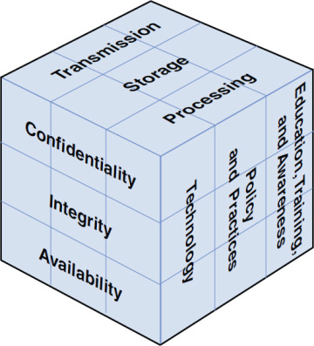
McCumber Cube
Policy Dimension:
Guidelines for handling sensitive user data.
Data encryption, access control, and consent management.
Mechanism Dimension:
Technical controls to safeguard against unauthorized access.
Secure authentication, encryption protocols, and regular security audits.
Assurance Dimension:
Verification and validation processes for security effectiveness.
Independent security assessments and compliance audits.
Application to Our Social Media App:
Ensures robust protection of user data and privacy.
Fosters a safe and secure environment for mental health support.
Notes:
The McCumber Cube framework offers a structured approach to information security, comprising three dimensions: Policy, Mechanism, and Assurance.
In our social media application, the Policy dimension involves establishing guidelines for handling sensitive user data, such as encryption protocols and consent management.
The Mechanism dimension focuses on implementing technical controls like secure authentication and encryption to prevent unauthorized access to user information.
Assurance encompasses verification and validation processes, including independent security assessments, to ensure the effectiveness of our security measures.
By integrating the McCumber Cube framework into our social media application, we can ensure robust protection of user data and create a safe and secure environment for mental health support.

Slide 8
Project Proposal
Social Media application where those with a focus on creating community between those with mental illnesses
Application will include resource sharing, access to volunteer mental health professionals, and content sharing
Notes:
Our project proposal revolves around the development and implementation of a social media application tailored specifically to address the mental health needs of individuals.
The proposed application will function similarly to popular social media platforms like Instagram and Facebook, allowing users to share their mental health experiences, access resources, and engage with supportive communities.
Through this application, users will have a safe and stigma-free space to express themselves, seek support from peers, and access valuable mental health resources and information.
The main objectives of our project proposal include providing accessible and inclusive mental health support, fostering a supportive online community, and raising awareness about mental health issues.
The aim is to create a user-friendly interface that prioritizes user privacy and security while offering features such as discussion forums, resource libraries, and personalized support networks.
Additionally, the project proposal outlines strategies for user engagement, content moderation, and community management to ensure a positive and impactful user experience.
By presenting this project proposal, we seek to address the critical need for accessible and stigma-free platforms for mental health support in today's digital landscape, ultimately promoting mental well-being and resilience in our community.

Slide 9

Requirements
User Engagement and Adoption
Access to Mental Health resources
Technical Infrastructure
Mental Health Professional Resources
Funding resources
Notes:
My project requirements outline the essential elements necessary for the successful development and implementation of our dedicated social media application for mental health support. These requirements encompass various aspects, including user engagement, access to resources, technical infrastructure, and funding resources. With conducting a survey, we can determine the need of the community that can be expressed in the application. This will make sure that we can make the application userful for the user base and promise that user engagement will be there. When completing this application, research needs to be made to determine the type of resources need by different mental illness to provide each one with resources. By prioritizing these requirements, we aim to create a platform that effectively addresses the needs of individuals grappling with mental health challenges while ensuring sustainability and scalability in the long run.

Slide 10

Budget
Direct Costs :
Pre-built social media framework: $50,000
A small team of developers: $100,000;
Marketing and promotional: $30,000;
Legal Counsel for continued compliance: $14,400;
Technology Stack: $103,000; (Smusin, 2022).
https://yellow.systems/blog/how-do-you-make-a-social-media-app-from-scratch
Total:$297,400
Supporting Costs:
Technical support and maintenance: $30,000;
Training sessions for moderators and administrators: $10,000;
Server hosting and infrastructure maintenance: $15,000 per annum;
Total: $55,000
Notes:
Rationale: In this official budget, the use of a pre-built social media framework overs advantages by reducing development time and costs, as well as access to established features and functionalities. This approach allows the project to leverage existing technologies and focus resources on customization and optimization to meet the specific needs of the platform. While using the pre-built framework, we need a small group of developers to customize the framework, integrate additional features, and ensure smooth operation. This budget allocation ensures sufficient manpower to handle development tasks efficiently while maintaining quality and timeliness. Allocating funds for marketing and promotion is crucial for raising awareness and attracting users to the mental health support platform. This budget allows for targeted marketing campaigns across various channels to reach the target audience effectively and drive user engagement and adoption. Ensuring ongoing compliance with regulations and legal standards is paramount for maintaining trust and credibility within the mental health support platform. This budget allocation covers the cost of legal consultation to address regulatory requirements, privacy concerns, and any potential legal issues that may arise during operation. The technology stack plays a crucial role in the functionality, scalability, and performance of the social media application. This budget allocation allows for the procurement of necessary software licenses, tools, and infrastructure components to support the platform's operations effectively.

Slide 11
Schedule
Project Planning
Gathering Requirements
Framework Selection
Team Recruitment
Framework Customization
Testing and Quality Assurance
Legal Compliance
Marketing and Promotion
Launch and Deployment
Notes:
My project schedule outlines the timeline and key milestones for developing and launching our dedicated social media application for mental health support. Each phase is carefully planned to ensure timely execution, resource allocation, and project management efficiency. By adhering to this schedule, we aim to deliver a high-quality application that effectively addresses the needs of individuals grappling with mental health challenges while meeting industry standards and user expectations. For example, in Project Planning that happened (January 15, 2024 - January 29, 2024): this phase, we laid out the basic project information, including scope, budget, and resource allocation.
In Gathering Requirements planned for(May 5, 2024 - May 19, 2024): This phase involves conducting surveys and research to understand user needs and preferences, particularly during Mental Health Awareness Month.
In Framework Selection and Setup planned for (September 5, 2024 - September 19, 2024): We'll evaluate different social media frameworks and set up the chosen framework for development.

Slide 12
Recommendations
User-centric design
Continuous Feedback
Collaborative partnerships
Regular updates
Robust security measures
Notes:
As we move forward with the development and launch of our dedicated social media application for mental health support, several key recommendations can help ensure its success and effectiveness. Firstly, prioritizing a user-centric design approach will be crucial in creating an intuitive and accessible platform that meets the diverse needs of our users. Secondly, establishing mechanisms for continuous feedback will allow us to stay responsive to user needs and preferences, fostering a sense of community ownership and engagement. Additionally, exploring collaborative partnerships with mental health professionals and advocacy groups can enrich the platform's resources and support offerings, enhancing its overall value to users. Furthermore, committing to regular updates and improvements based on user feedback and emerging trends in mental health support will be essential in keeping the platform relevant and impactful. Lastly, maintaining robust security measures to safeguard user data and privacy will be paramount in earning and maintaining user trust in the platform. By implementing these recommendations, we can create a social media platform that truly makes a positive difference in the lives of individuals grappling with mental health challenges.

Slide 13
Questions

Slide 14
Mental Health Social Media Application
By:Shirdora Ashe

Slide 15
References
Adult Data 2022 | Mental Health America. (n.d.). Mental Health America. Retrieved April 8, 2024, from https://mhanational.org/issues/2022/mental-health-america-adult-data#:~:text=Adult%20Prevalence%20of%20Mental%20Illness%20(AMI)%202022&text=19.86%25%20of%20adults%20are%20experiencing,experiencing%20a%20severe%20mental%20illness.
Dixon, S. J. (n.d.). Instagram users worldwide 2025 | Statista. Statista. Retrieved April 15, 2024, from https://www.statista.com/statistics/183585/instagram-number-of-global-users/#:~:text=In%202021%2C%20there%20were%201.21,percent%20of%20global%20internet%20users.
How Many People Use Instagram? [Updated Jan 2024] | Oberlo. (n.d.). Oberlo | Where Self Made Is Made; Oberlo. Retrieved April 8, 2024, from https://www.oberlo.com/statistics/how-many-people-use-instagram#:~:text=Instagram%20users%20statistics%3A%202020%E2%80%932025&text=This%20figure%20has%20been%20growing,in%20the%20past%20few%20years.
Naslund, J., Bondre, A., Torous, J., & Aschbrenner, K. (2020, April 20). Social Media and Mental Health: Benefits, Risks, and Opportunities for Research and Practice - PMC. PubMed Central (PMC). https://www.ncbi.nlm.nih.gov/pmc/articles/PMC7785056/
Vaingankar, J., van Dam, R., Samari, E., Chang, S., Seow, E., Chua, Y., Luo, N., Verma, S., & Subramaniam, M. (2022, March 4). Social Media–Driven Routes to Positive Mental Health Among Youth: Qualitative Enquiry and Concept Mapping Study - PMC. PubMed Central (PMC). https://www.ncbi.nlm.nih.gov/pmc/articles/PMC8933808/
Young, A. S., Cohen, A. N., Niv, N., Nowlin-Finch, N., Oberman, R. S., Olmos-Ochoa, T. T., Goldberg, R. W., & Whelan, F. (2020). Mobile Phone and Smartphone Use by People With Serious Mental Illness. Psychiatric Services, 3, 280–283. https://doi.org/10.1176/appi.ps.201900203
Notes:
And here is my references.

